Slide 1
2024 SIOP Machine Learning Competition
Team Hungry Llama
Jennifer Gibson, PhD, PStat®
April 2024
Notes:
We are particularly interested in learning about your journey throughout the competition, including any insights, successes, or setbacks you experienced along the way. Your presentation should provide a comprehensive overview of your work, showcasing your expertise and the unique perspective you brought to the competition.

Slide 2
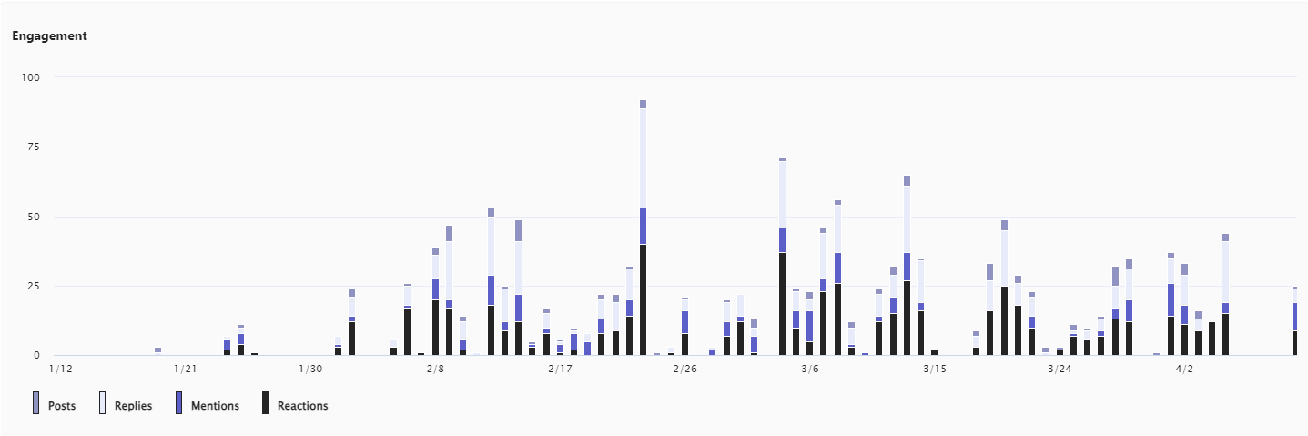
Team Processes
MS Teams activity over two months
Recruitment
Specialties
All levels welcome
Divide tasks but share ideas and code
MS Teams
Weekly huddle
Naming
Levels of Involvement
Lead
Contribute
Observe

Slide 3

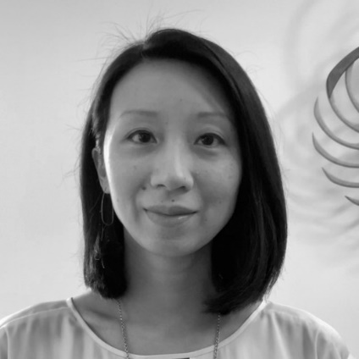

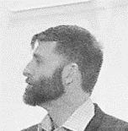
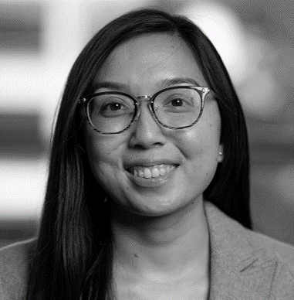

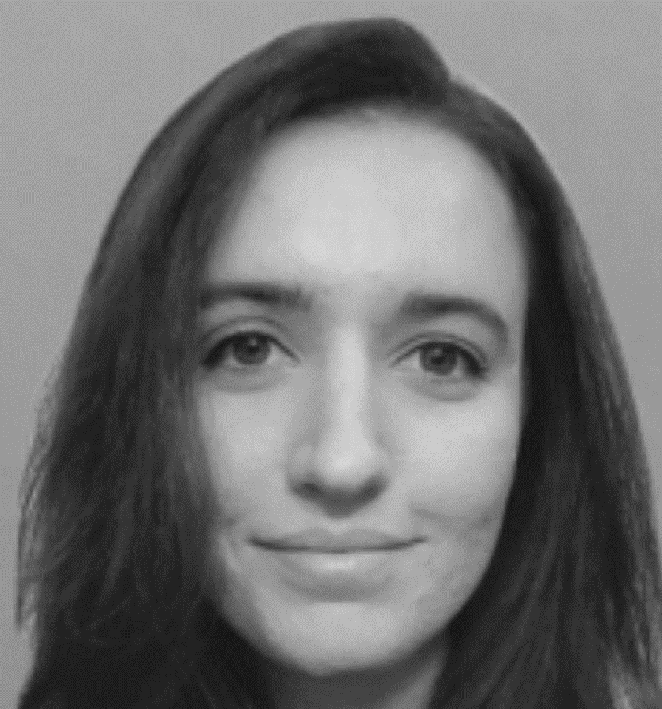
Hungry Llama
Shane Halder
Task 1 Lead 1∙2∙3
Jen Gibson
Task 2 Lead 2
Blake Hoffman
Task 3 Lead 3
Joe Luchman
Task 1 Lead 3∙4
Selena Tran
1
Nick McCann
3
Hannah Johnson
1

Slide 4
Learning Journey: Solution Quality Over 40 Submissions

Slide 5
Task 1: Empathy
Notes:
Predicting Empathy: Job candidates were asked to provide empathetic responses to a difficult workplace situation. Your task is to classify whether empathy was demonstrated or not in each simulated response.
_id text empathy
116 Hi Jonathan, I hope this message finds you well. I hear things are going well with the Beta project. That said, Terry mentioned that there were some issues with the reports…1

Slide 6
Evolution of the Empathy Solution
Initially tried machine-learning algorithms to model Basic Empathy Scale (BES) emotions
Fear, Sadness, Anger, and Happiness
Python packages such as NRCLex, VADER, TextBlob, and Roberta GoEmotions
Tried using cosine similarity among training cases
Tried an ensemble of ML, Mistral 7B zero-shot, and cosine similarity
Needed to break empathy down based on how it was rated in the data vs the LLMs interpretation of what empathy is; came up with multiple prompts rating empathy in different ways
ChatGPT 3.5 Turbo but did not perform as well as Mistral
Notes:
Jolliffe, D., & Farrington, D. P. (2006). Basic Empathy Scale (BES) [Database record]. APA PsycTests.
https://doi.org/10.1037/t42339-000

Slide 7
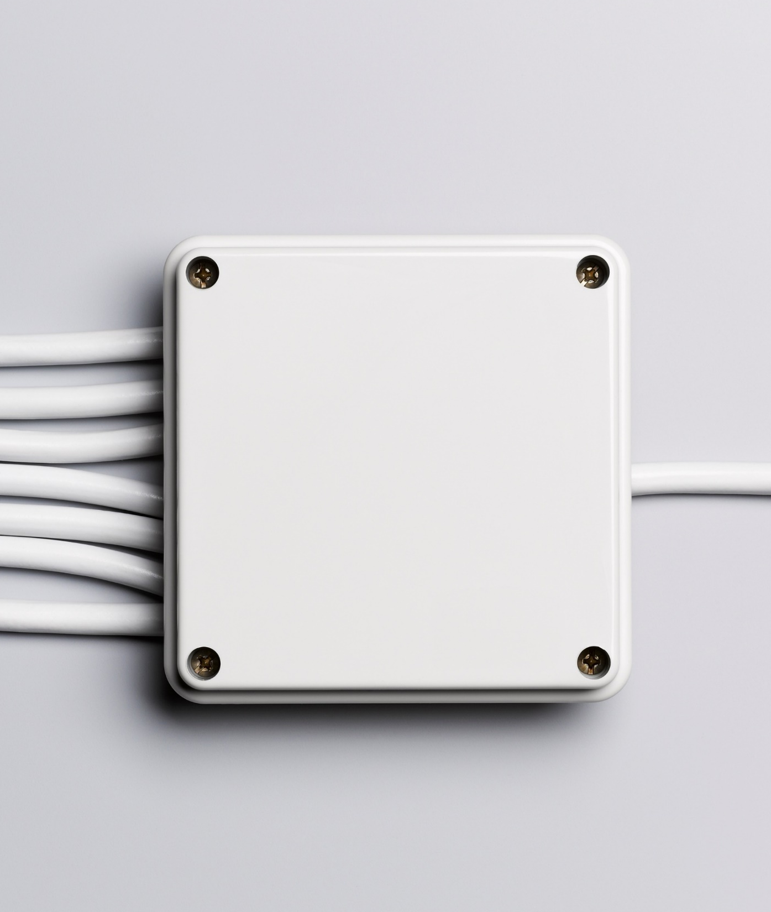
Approach
Programmed in Python
Uses the following LLMs via the Hugging Face API:
Mistral-7B-Instruct-v0.2
Mixtral-8x7B-Instruct-v0.1
Quantify empathy in 9 metrics:
8 different LLM prompts (empathy few-shot, sentiment zero-shot, negativity zero-shot, approval zero-shot, appreciation zero-shot, support zero-shot, rapport building zero-shot, empathetic phrases zero-shot)
1 harsh words regular expression pattern matching
Predictions via weighted metric sums and cutoffs

Slide 8
Predicting Empathy
LLM Prompt Template & Parameters:
prompt_template = {
"inputs": f"<s>[INST] {prompt}[/INST]",
"parameters": {
"do_sample": False,
"max_new_tokens": 2000,
"top_p": 0.9,
"top_k": 1,
"repetition_penalty ": 1,
"presence_penalty": 0,
"frequency_penalty": 0,
"return_full_text": False
}
}

Slide 9
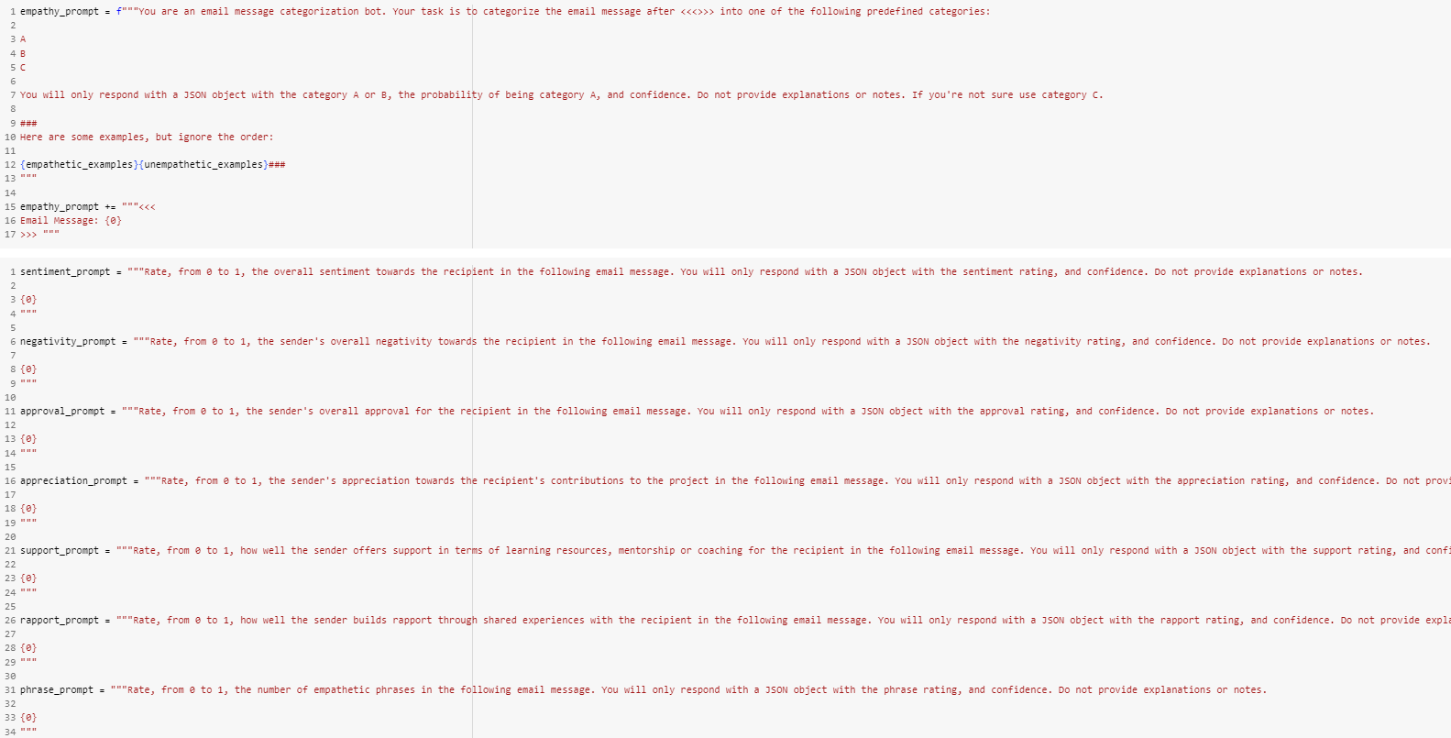
Predicting Empathy
LLM Prompts:
Empathy
Sentiment
Negativity
Approval
Appreciate
Support
Rapport
Phrases

Slide 10
Task 2: Interview
Notes:
Generating Interview Responses: Job candidates responded to 5 common interview questions. You will be given the text of 4 question and response pairs. Your task is to generate a likely text response for the 5th question based on the previous responses.
_id R_2q2WQ6Icq6pcuvZ
last_answer
When motivating a team, I try to persuade them. I try and show them why they should be motivated. An example is explaining the pros and cons, showing them how the pros are worth it. A setting where this is effective is in a group project. Telling my team that if they spend more time outside of class, they will likely produce a better product resulting in a better grade, can be motivating.

Slide 11
Evolution of the Interview Solution
Python, Google Colab, Mistral 7b HF API, Mixtral8x7b HF API, ChatGPT (3.5 and 4) API, and ChatGPT Plus
Develop an idea of the job candidate’s way of responding and use that to guess what they would say in response to Q4
Personality and emotion
Added Big 5 dimensions in groups
Tone and emotion from A1-A3
Varied combinations and thresholds, terminology
Use basic characteristics of A1-A3: Number of words or sentences
Encode Flesch reading level

Slide 12
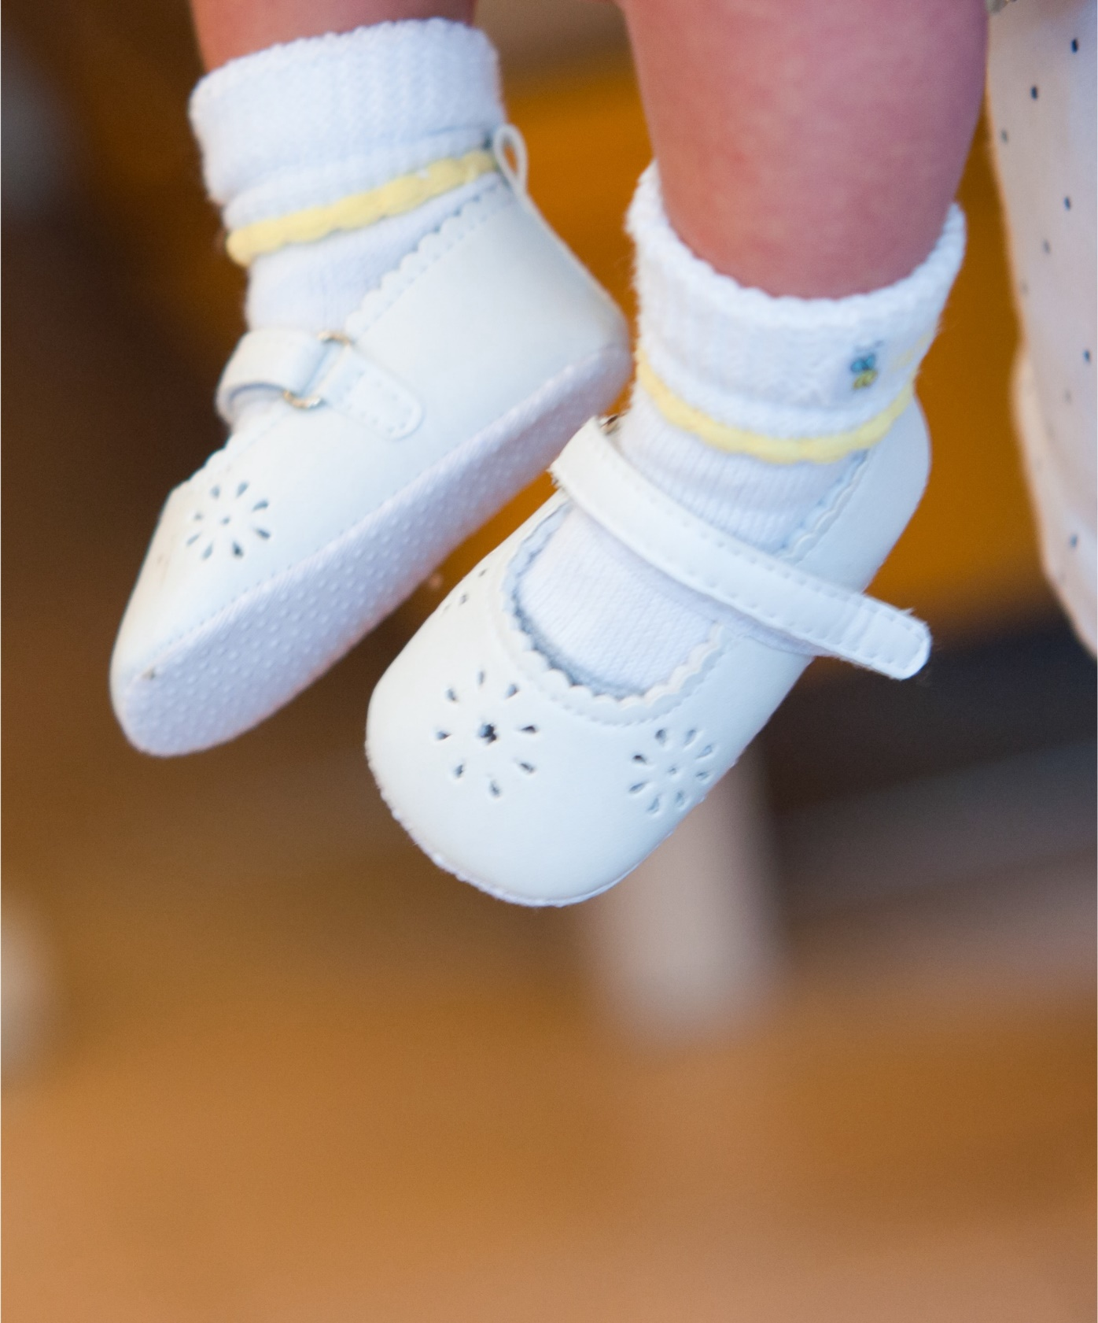
Approach
ChatGPT 4
Restate the question
Big 5 (Example: Be more/less extraverted than average)
Basic characteristics of A1-A3
Average sentences across answers
Number of words or sentences
Average reading level across answers
Example: Write at the reading level of a middle school/high school/college graduate and professional audience
Varying the prompt

Slide 13
Variants That Did Not Improve Prediction
Instead of “Be similar in tone”
Textblob polarity
Vader polarity
Emotion scores from NLP packages (e.g., fear, joy, surprise)
Mistral
Mimic basic characteristics of most recent answer (A3)

Slide 14
Example Prompt
[Questions Q1-Q4 and Answers A1-A3]
Generate a response for the provided question following these rules:
Start with a restatement of the question
Have a similar writing style
Write at least [3] sentences
Be similar in tone
Be [more extraverted] than average
Be [less conscientious] than average
Be [less open to new experiences] than average
Be [less neurotic] than average
Be [less open to new experiences] than average
Write at the reading level of [a college graduate and professional audience]

Slide 15
Task 3: Clarity
Notes:
Rating Item Clarity: Respondents rated the clarity of personality test items using a 7-point scale from 1 = extremely unclear to 7 = extremely clear. Your task is to predict the average clarity rating for each item based on the responses.
_id personality_item clarity
0 Am considered well-off financially. 3.421053
1 Make problems bigger than they are. 6.545455
2 Judge people by their appearance. 6.545455
3 Did not feel like eating, even though I should have been hungry. 3.75
4 Feel that very few merchants take advantage of their customers. 5.210526

Slide 16
Evolution of the Clarity Solution
Initially tried a single zero-shot and few shot rating by Mixtral
Tried variants of random forests, gradient boosters, and model averaged regressions
Used ratings from Llama 2.0, individual ratings from Mixtral 8x7B, used ratings from OpenChat 3.5
Tried using all NLP features and all 1,024 embedding features
Best solution up until 2 weeks prior to test data release was randomly guessing between values of 5.5 and 6.5 but using a value of 3 for cases with any phrase with ‘am’ , a comma, or negation
Python (NLP encoding) and R (everything else)

Slide 17

Approach
Process the data: Add NLP features
Generate personality ratings for each phrase (zero-shot)
Generate clarity ratings directly (few-shot)
Generate final predictions of clarity

Slide 18
Process the Data
Nineteen Python nltk- and vader-based features including:
Does phrase contain word “am”, a comma, include negation (i.e., “not”).
Flesch reading ease and difficult word count.
Phrase sentiment and subjectivity
Parts of speech including adjective, pronoun, past tense verbs, etc.
Word embeddings obtained from user intfloat’s ‘multilingual-e5-large’ Hugging Face model called with httr2 in R.
Generate a single average embedding score
All 1,024 features
averaged within row to obtain a single average embedding score.

Slide 19
Generate Personality Ratings
Zero-shot classification from Facebook’s Bart model on Hugging Face called with httr2 in R.
Each phrase was rated on the probability it belonged to one of the Big 5 personality traits.
The proportions were logit-transformed.
The standard deviation of the logit-transformed probabilities was used as a metric of classification uncertainty
Big 5
Personality Traits
Openness to Experience
Neuroticism
Conscientiousness
Extraversion
Agreeableness

Slide 20
Generate Intermediate Clarity Ratings
MistralAI’s Mixtral 7x8B model on Hugging Face called with httr2 in R.
Ten different direct ratings of clarity with 20 different training examples randomly selected from training data.
Combined the 20 training examples in the following way:
"<s> [INST] -- context -- Learn from the examples. Respond with a number between 1 and 7. Do not explain your reasoning. -- examples -- Am considered well-off financially. [/INST] 3 [INST] Do not exercise ... </s> [INST] Rarely overindulge. [/INST]
Note the use of Mixtral’s special tags to identify past conversation (i.e., <s> and </s>) and instructions (i.e., [INST] and [/INST]).
First mention of a digit was used as the rendered clarity rating.

Slide 21
Generate Final Predictions of Clarity
R’s ranger package with extratrees method/extremely randomized forests.
The average direct rating, 6 personality ratings, and 20 NLP features used. Trained on training data and applied to test data.
Top 5 training features:
Did phrase have ‘am’ in it?
Average Mixtral rating for clarity
Did phrase have negation?
Difficult word count
Pronoun count
01
02
03
04
05

Slide 22
Task 4: Fairness
Notes:
Identifying Fairness Perceptions: Respondents compared two organizational policies and voted on which was fairest. Your task is to identify which policy received the majority vote as the fairer option.
_id first_option second_option majority_vote
0 Conflict Resolution Workshops: We conduct regular workshops to equip employees with conflict resolution skills.
Conflict Resolution Workbooks: Resources are provided to employees for self-guided conflict resolution. first
1 Conflict Resolution Peer Mentoring: Experienced employees mentor newcomers in conflict resolution.
Diversity and Inclusion Training: Programs that promote understanding and reduce conflicts related to diversity. second
2 Mediation sessions are scheduled outside of regular working hours for convenience.
Employee Conflict Coaches: Coaches work one-on-one with employees to resolve disputes. second

Slide 23
Evolution of the Fairness Solution
Initially tried a single zero-shot rating by Mistral 7B – which was nearly as good as the final method
Final method devised in 3rd dev submission (of 40 total!)
Used a variation on the prompts to include special Mixtral tags discussed in Task 3
Used method like the Mixtral-based method in Task 3 where Mixtral received fewer training examples but had 10 different ratings and were combined in an extremely randomized forest
R only

Slide 24

Approach: Few-Shot Learning with Mixtral
Select training observations
Develop prompt
Submit prompt to Mixtral 7x8B and parse

Slide 25
Select Training Observations
Randomly remove 1 of the 24 rows from training sample.
prompts_selected <- fair_train_df |> dplyr::slice_sample(n = 23)
Twenty-three chosen to match training approach where all but focal row is used.
Hence, 23 rows.
Sampling seed set with assistance from RANDOM.org’s random number generator.

Slide 26
Develop Prompt: Offer Context
Combine and label all 23 few shot instances like:
Question {x}: Which option is fairer? Option 1 = Conflict Resolution Workshops: We ... Option 2 = Conflict Resolution Workbooks: Resources ... Answer {x}: Option 1 ...
Where {x} is a number between 1 and 23.
Include an incomplete from the test data at the end like:
Question 24: Question {x}: Which option is fairer? Option 1 = Employees can request a transfer ... Option 2 = Arbitration: We offer a neutral ... Answer 24:

Slide 27
Develop Prompt: Question for Mixtral
Mixtral is asked to:
Answer Question 24 below given the responses to Questions 1 through 23 above. Only respond with 'Option 1' or 'Option 2' and do not explain your reasoning. The order of 'Option 1' and 'Option 2' is random. Do not use the order that the options appear when judging which is fairer. The order of Questions 1 to 23 is random. Do not use the order in which the questions to judge the fairness of the options.
PROMPT

Slide 28
Submit Prompt
Mixtral 7x8B on HuggingFace called using httr2
Parameters to Mixtral were identical to those in ‘clarity’ task
First response of ‘Option 1’ or ‘Option 2’ was used as the rendered fairness judgment even if more than one was reported back by Mixtral
SUBMIT

Slide 29
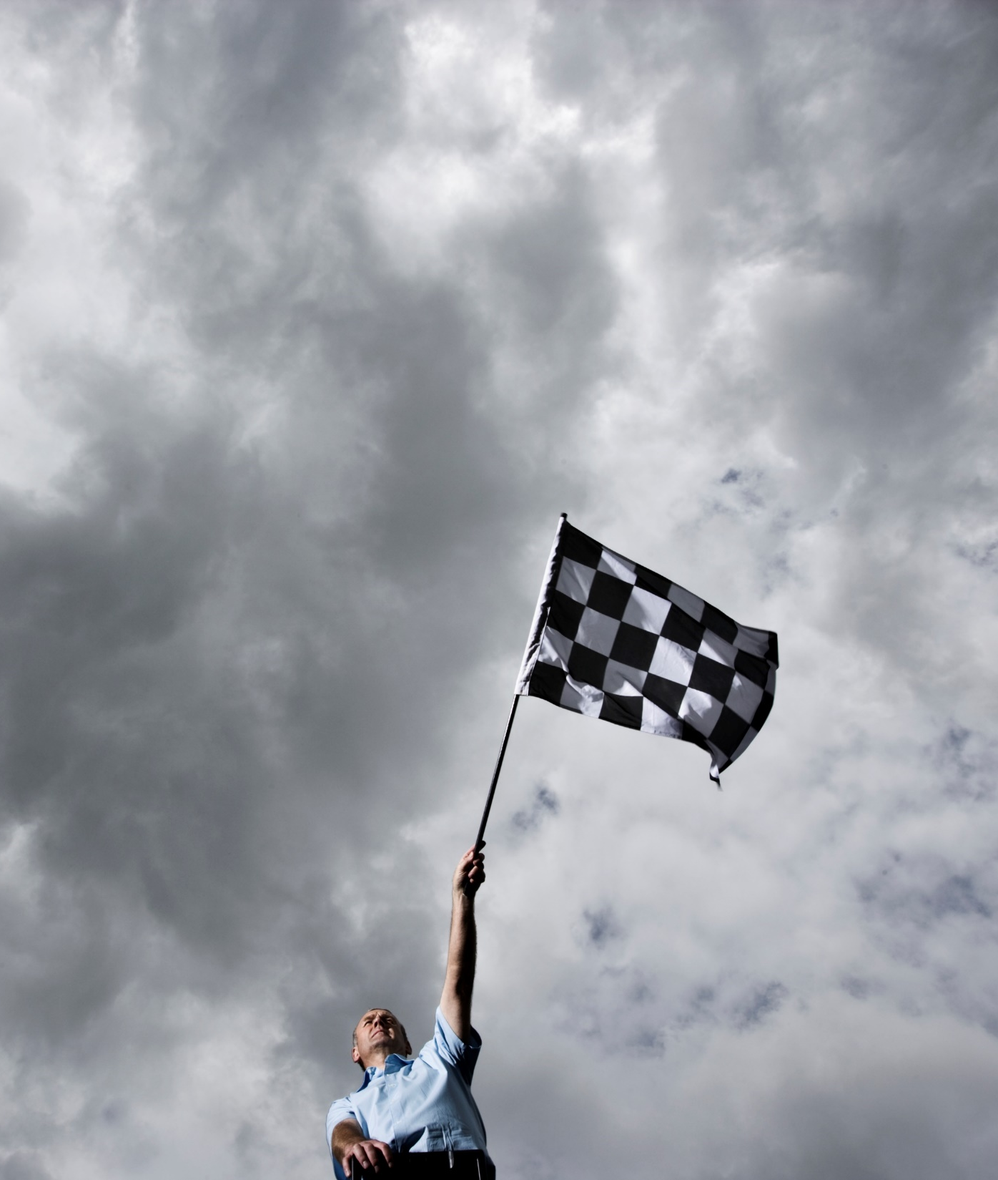
Final Five
Select top 3 solutions for each of the tasks
Fourth submission: Submit best of (highest score)
Fifth submission: Submit best of with one last change

Slide 30
Acknowledgements

